Slide 1

Incorporating technology into the curriculum and educating the educators
Dr Craig Alexander & Dr Vinny Davies,
University of Glasgow

Slide 2
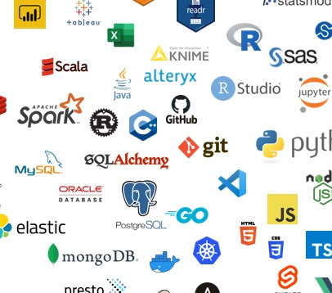
Should Statistics Education embrace new technologies?
Yes, with some caveats
If they enhance learning or real-world relevance.
But they must integrate well within the curriculum.
For students, such tools are key for employability. We do want to avoid overloading students though.
Teaching responsible use of ‘less-trusted’ technology (e.g. GenAI)
Are these used in practice? (industry, academia, government) And how?
http://dev.to/minchulkim87/my-data-science-tech-stack-2020-1poa

Slide 3



Should Statistics Education embrace new technologies?
Use of new technology in practice:
Industry – Focus on ‘in-demand’ tools, lot of cloud computing, GenAI use, version control
Academia – A shift to reproducibility (Github), emergence of more AI/deep learning approaches
Government – Focus on transparency and security, using R
How do we decide what to cover?
How do we adapt?

Slide 4
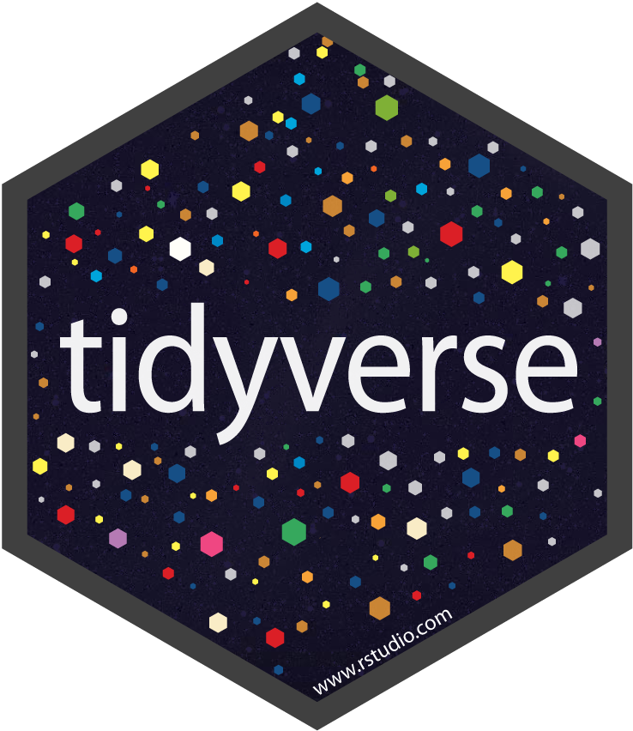


Current Adaptions - R
Many institutions will use R as the primary programming language for teaching statistics.
R has grown massively over recent years in terms of functionality (Rstudio, tidyverse, Shiny, etc.)
More recent changes:
Quarto – An ‘update’ on RMarkdown – easier to use, cleaner integration with Python/Julia.
Shiny – available in Python from 2022
Tidyverse – it changes constantly!
Most (if not all) of these changes are updated regularly within the curriculum.

Slide 5

Programming - Python
The inclusion of Python to the curriculum is most likely ‘step 1’ of modernisation.
Though the case is strong (clear industry demand, better for ML/AI modelling), integration has to be carefully considered.
We can’t simply just ’teach’ a Python course and move on!
https://rstudio.github.io/reticulate/

Slide 6

Multi Code Integration
For students to properly learn new technologies, they should be integrated throughout the programme.
A current debate at Glasgow is how much integration is needed? Is this for all courses/just some?
Some methods are more suited to R use, others to Python. The rest sit in the middle, and can be used across both.

Slide 7
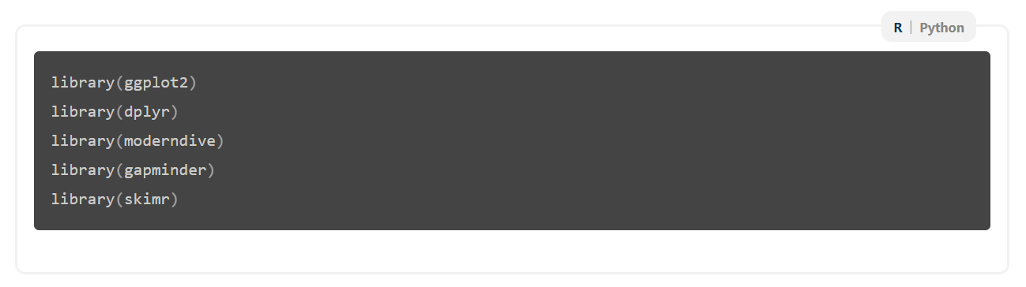
R-Python Integration
Jack, E., Alexander, C., McArthur, D., & Mair, C. (2023). Reflections on designing and delivering an online distance learning programme in the mathematical sciences. MSOR Connections, 21(2), 25-33.
Our accessible notes now allow switching between languages or descriptions
We can also use it for R vs Python

Slide 8
R-Python Integration
Jack, E., Alexander, C., McArthur, D., & Mair, C. (2023). Reflections on designing and delivering an online distance learning programme in the mathematical sciences. MSOR Connections, 21(2), 25-33.
Our accessible notes now allow switching between languages or descriptions
We can also use it for R vs Python

Slide 9
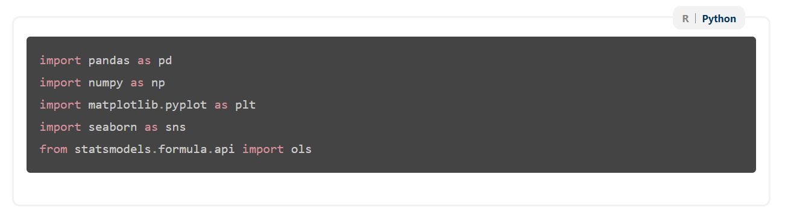
R-Python Integration
Jack, E., Alexander, C., McArthur, D., & Mair, C. (2023). Reflections on designing and delivering an online distance learning programme in the mathematical sciences. MSOR Connections, 21(2), 25-33.
Our accessible notes now allow switching between languages or descriptions
We can also use it for R vs Python

Slide 10
Multi Code Integration
The good – Students have exposure to both languages in the programme.
The problem – How many staff know Python to do this?
Do staff have to learn Python?
It depends – code for some courses may be easier to create over others
How can we support this?

Slide 11

Version Control
Version control is becoming an ever-increasing feature within roles across academia and industry in statistics.
How do we integrate teaching version control into our learning and teaching practice?

Slide 12
Version Control
Some things we have done at Glasgow:
Created a short Version Control course. Designed for staff & students and currently taught across several programmes.
Using version control in assessments – great for group projects.
Programme design – using Github to share course materials
Similar issues with learning Python for staff, though training through the short course has worked well, and several staff use version control within their research.

Slide 13

Machine Learning
The use of machine learning is common in industry – clear demand to cover these methods.
We don’t want to teach a ‘black-box’ style course, explain why models work, when to use them.
Use classical methods to motivate ML use
Coding – R can do a lot of these things, but Python can be better (tidymodels seems to be a new R solution)
How much do we cover? How many courses?

Slide 14

AI
Like machine learning, AI is also an emerging skill.
Adding new skills such as computational scaling & learning when to use AI models over classic methods.
Coding – Python is best here. R can be integrated but, in my experience, it’s tough!
What to cover – big danger of overload within the curriculum covering too much.

Slide 15

ML & AI - Challenges
How do we teach ML/AI?
Avoid the ‘black-box’ approach and provide motivation on when to use certain approaches
How much do we teach? If we covered common deep learning methods, it would likely need 4 courses to cover it all!
Staff expertise – How much do we all know about these methods?
Staying relevant – Many ML/AI approaches evolve constantly, can we keep up to date?

Slide 16

Generative AI
How and whether to teach Generative AI (GenAI) has the same challenges
It seems like its going to be a big part of our lives moving forward
Over to Vinny to talk about what we are planning…

Slide 17
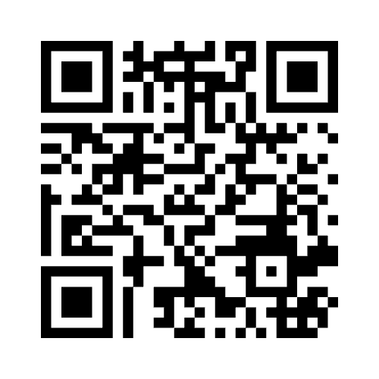
Mentimeter
8596-9968

Slide 18
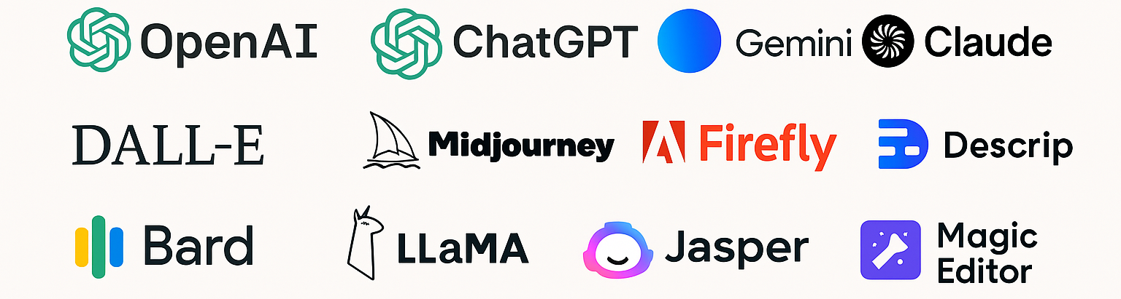
Teaching GenAI
What do we mean by teaching GenAI?
In this context, we mean teaching people how to use tools such as ChatGPT “properly”
What is “properly”?
How do we do this in the context of statistics?

Slide 19
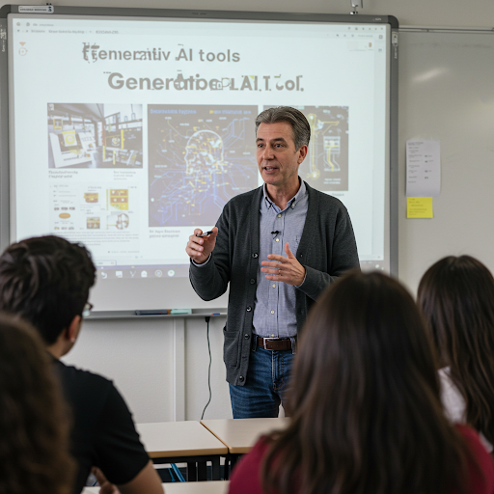
Why should we teach GenAI?
Policy at many institutes allows the use of GenAI
Our students and staff are using it whether we want them to or not
Students will use it in jobs once they graduate. How can they use it safely and effectively if they don’t understand it?
Can you see the 2+ major issues in this image?

Slide 20
Why should we teach GenAI?
Policy at many institutes allows the use of GenAI
Our students and staff are using it whether we want them to or not
Students will use it in jobs once they graduate. How can they use it safely and effectively if they don’t understand it?
Can you see the 2+ major issues in this image?

Slide 21
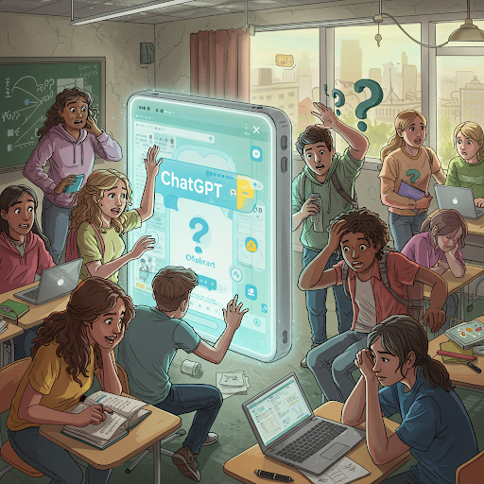
Students and GenAI
Currently our students are using it badly
We tried to encourage its more open use this year through the traffic light system
Students don’t understand how to learn from it, nor probably do staff or industry
Students tend to just throw entire questions into their favourite tool and don’t check what comes back out

Slide 22

Staff and GenAI
Its not just students… staff are using it badly as well…
They are using it where they shouldn’t be, and not where they maybe should be
Many just don’t understand what it is? Or how to use it effectively
Could it be used in a research context? UKRI allows it… I know Profs who already use it to write grants…

Slide 23

Industry and GenAI
Industry often using it without knowing what it is
Some industries are actively encouraging its blanket use to keep the competitive edge
Others are outright banning it, as they are worried about the consequences
None seem to be thinking about documenting its use
Over 20 companies have agreed to help with this course

Slide 24
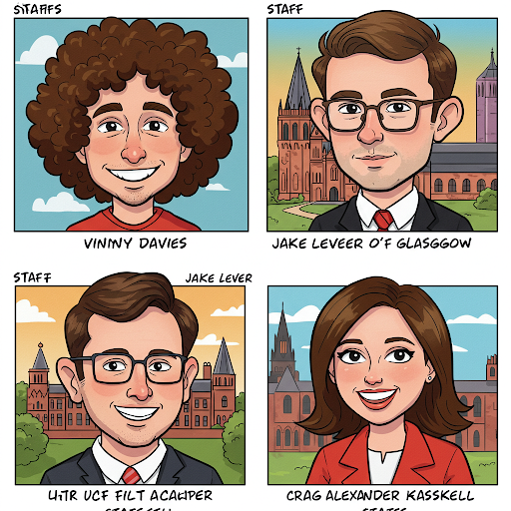



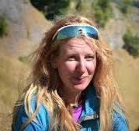
Are we GenAI experts?
Our team at the University of Glasgow are trying to help
We want to design a course which can help people self-evaluate where and how they use GenAI
Are we experts? No, with the exception of Jake!
We still think we can help anyways, our school certainty seems to think we know what we are doing (shows how much they know!)
Vinny Davies
Jake Lever
Craig Alexandar
Jenn Gaskell

Slide 25
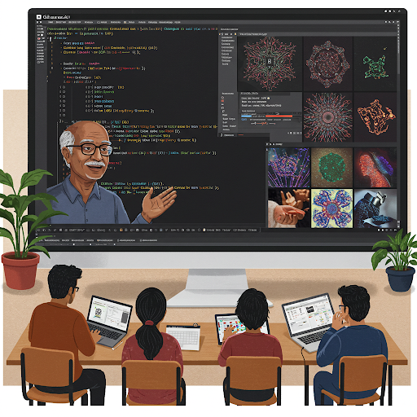
What is our course about?
It does not aim to teach the theory of Large Language Models or even neural networks
It does not aim to tell people what they should and shouldn’t do with GenAI
It does aim to encourage people to self-evaluate their own use or potential use of GenAI
It does aim to give them things to think about when using GenAI in the context of Data Science

Slide 26
Key Themes
The course structure is based around 4 key themes
Education – Understanding the strengths and weaknesses of GenAI
Development – How to use GenAI to learn and develop code/models
Reporting – Thinking about when and where it might make sense to document what has been done
Safety – Things to consider when setting guidelines
We welcome any feedback or suggestions

Slide 27
Education
Aim: To give the key concepts behind GenAI and how it works
How does it work? – How does an LLM “know” things? Where does it get the data from and how does it generate text?
What are its limitations? – Covering a range of issues such as ethics, diversity, hallucinations, bias, and higher order skills
Staying Safe with GenAI – Topics such as critical evaluation, fact checking, limitations, and information corruption in content

Slide 28
Development
Aim: Make people consider how to use GenAI in an effective manner
Learning Strategy – How do we go about learning things using GenAI? How do we map a path from what we know to what we don’t
Development Strategy – Working out what GenAI can be used for in a project. What aspects of the project might it be helpful or unhelpful with?
Effective Usage – Thinking about effective ways to communicate with GenAI tools. Avoiding effective prompting literature, just giving things to think about

Slide 29
Reporting
Aim: Make people consider how they record how they have used GenAI
Generative Process – What code was generated using GenAI? How was it tested? What systems or modelling will rely on it in the future?
Regulations & Reporting – What internal or external regulations need to be considered? Has it been discussed this with a manager or supervisor?
Ethics – Are there any ethical considerations from what you have used GenAI to do? Could someone be negatively affected by GenAI’s in build biases?

Slide 30
Safety
Aim: Help organisations thing about how they govern the use of GenAI
Education – What training do people need to use GenAI safely and effectively? What do people need to know?
Risks – What are the specific risks for the relevant tasks? How can issues be compounded by overuse of GenAI?
Processes & Documentation – What processes, document, and guidelines need to be put in place? How do you ensure these are read and adhered to?

Slide 31
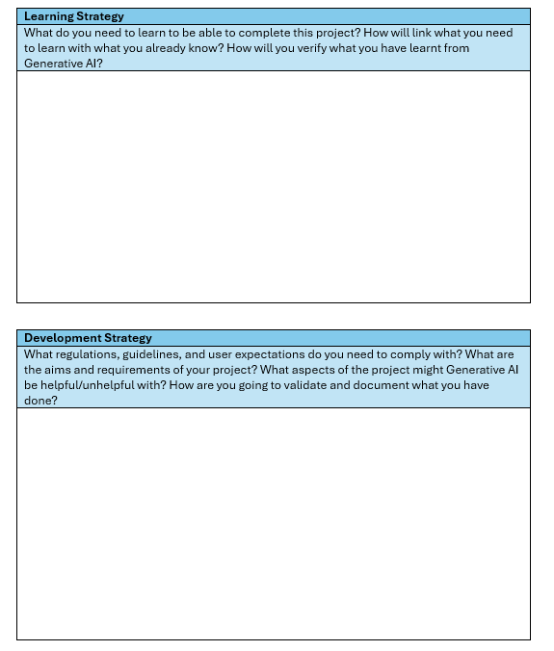
Worksheet
Creating a worksheet that can be used to encourage critical thinking and evaluations
People can take their own tasks (in person) or a generic task (MOOC) and evaluate the task against our 4 key themes
Allows us to help without giving definitive solutions
Future proofs the course

Slide 32
Using the course
We are aiming to use the course in several different ways
Students – Materials will be integrated into new courses designed to give students improved workplace skills
Staff – Training will be offered within our school and beyond. Seminars can be offered to other institutes
Industry – Workshops and seminar type sessions will be available
MOOC – We have funding to create a MOOC, making the course widely available

Slide 33

Thanks for Listening
Let us know if you have any questions or suggestions
Or feel free to reach out at:
Craig.Alexander.2@Glasgow.ac.uk
Vinny.Davies@Glasgow.ac.uk
Slides available at:
https://github.com/vinnydavies/presentations/2025

